Slide 1
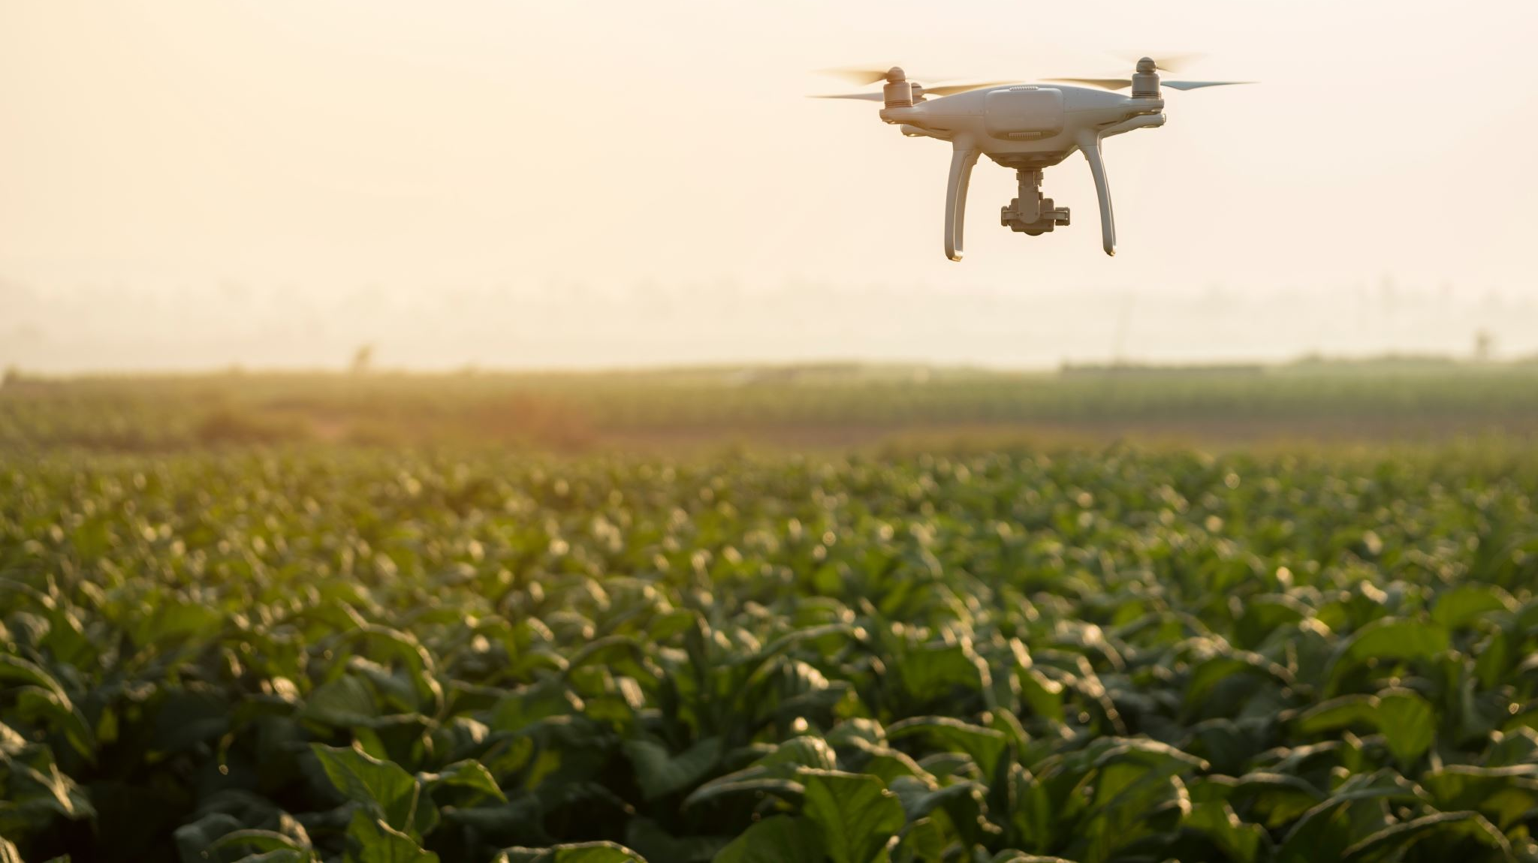
Unmanned Aerial Vehicle (UAV)
Iqmal Hakimi Bin Razali
1912103

Slide 2
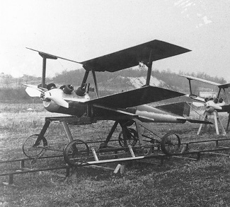
History of UAV
During the Siege of Venice in 1849, Austrian forces launched an unmanned balloon attack on the city using explosives. This was the first time an unmanned aerial vehicle was used in warfare.
The Kettering Bug, an unmanned aerial torpedo that was launched from the ground and controlled by a gyrocompass, was created by the US Navy during World War I. Although the Bug failed in battle, it represented a significant advancement in UAV technology.

Slide 3
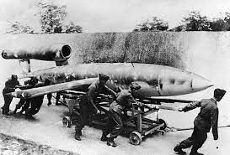
The Fairey Queen was a radio-controlled target aircraft created by the British Royal Navy in the 1930s that could mimic the flight patterns of enemy bombers. Anti-aircraft gunners were trained aboard The Queen.
The German Luftwaffe created the V-1 flying bomb during World War II; it was an unmanned missile that could be launched from the ground and was controlled by a crude autopilot. London and other British cities sustained substantial damage as a result of the V-1.
The US Air Force created the Q-2C target drone, a jet-powered aircraft with remote control capability for training, in the 1950s. Later, the Q-2C underwent modifications for surveillance and reconnaissance operations.

Slide 4
Applications of UAV
Aerial Photography and Videography: UAVs equipped with high-resolution cameras can be used to capture stunning aerial photos and videos for a variety of purposes, including real estate, tourism, filmmaking, and more.
Agriculture: UAVs can be used to survey crops, monitor plant health, and identify areas that require attention. This data can help farmers make more informed decisions about their crops and increase their yields.
Search and Rescue: UAVs can be used to search for missing persons or to locate people in areas that are difficult to access. UAVs equipped with thermal imaging cameras can detect body heat, even in the dark.
Disaster Relief: UAVs can be used to assess the damage caused by natural disasters such as earthquakes, floods, and hurricanes. This data can help emergency responders identify areas that require the most attention.
Environmental Monitoring: UAVs can be used to monitor wildlife, track changes in ecosystems, and measure pollution levels in the air and water.
Infrastructure Inspection: UAVs can be used to inspect bridges, power lines, and other infrastructure for signs of damage or wear and tear. This data can help maintenance crews identify problems before they become serious.
Delivery Services: UAVs can be used to deliver packages and other items to remote or hard-to-reach locations.
Military and Defense: UAVs have been used extensively in military and defense applications, including reconnaissance, surveillance, and target acquisition. Armed UAVs have also been used in combat operations.

Slide 5
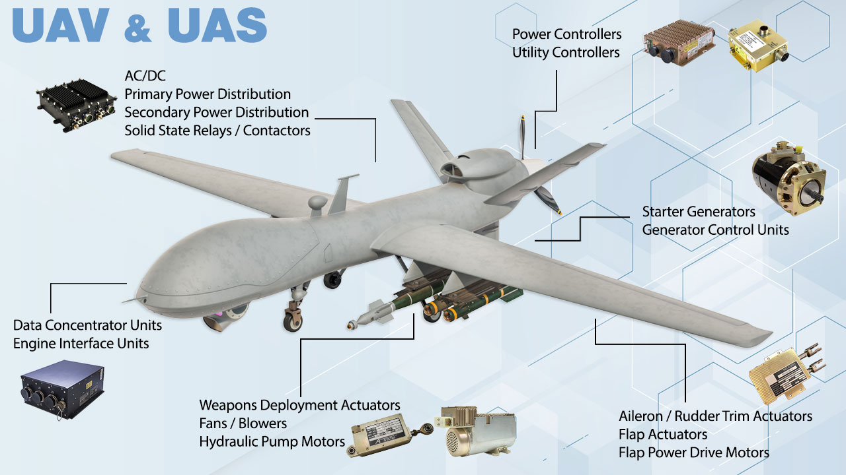

Slide 6
Main Components of UAV
Hull Design
Propulsion System
Navigation System & Control
Data Collection
Data Transmission
Power Management

Slide 7
Hull Design
Fuselage: The fuselage is the main body of the UAV and contains the electronic components, sensors, and payloads. The size and shape of the fuselage depend on the size and weight of the UAV and the intended mission.
Wings: The wings provide lift and stability to the UAV during flight. The shape and size of the wings depend on the desired flight characteristics and the operating environment. For example, a glider UAV may have longer wings than a quadcopter UAV.
Tail: The tail provides stability and control during flight. The tail includes the horizontal stabilizer, which prevents the UAV from pitching up or down, and the vertical stabilizer, which prevents the UAV from yawing or spinning.
Landing Gear: The landing gear is used to support the UAV during takeoff and landing. The landing gear can be fixed or retractable, depending on the UAV's operating environment and mission requirements.
Materials: The materials used to construct the UAV's hull depend on the intended mission and operating environment. Common materials include carbon fiber, fiberglass, aluminum, and plastic.
Shape: The shape of the UAV's hull can affect its aerodynamics and flight performance. Some UAVs have a sleek, aerodynamic design for high-speed flights, while others have a more bulky design for increased payload capacity.
Payload Bays: Many UAVs have payload bays or compartments for carrying cameras, sensors, and other equipment. The size and shape of these compartments depend on the size of the payload and the UAV's mission requirements.

Slide 8
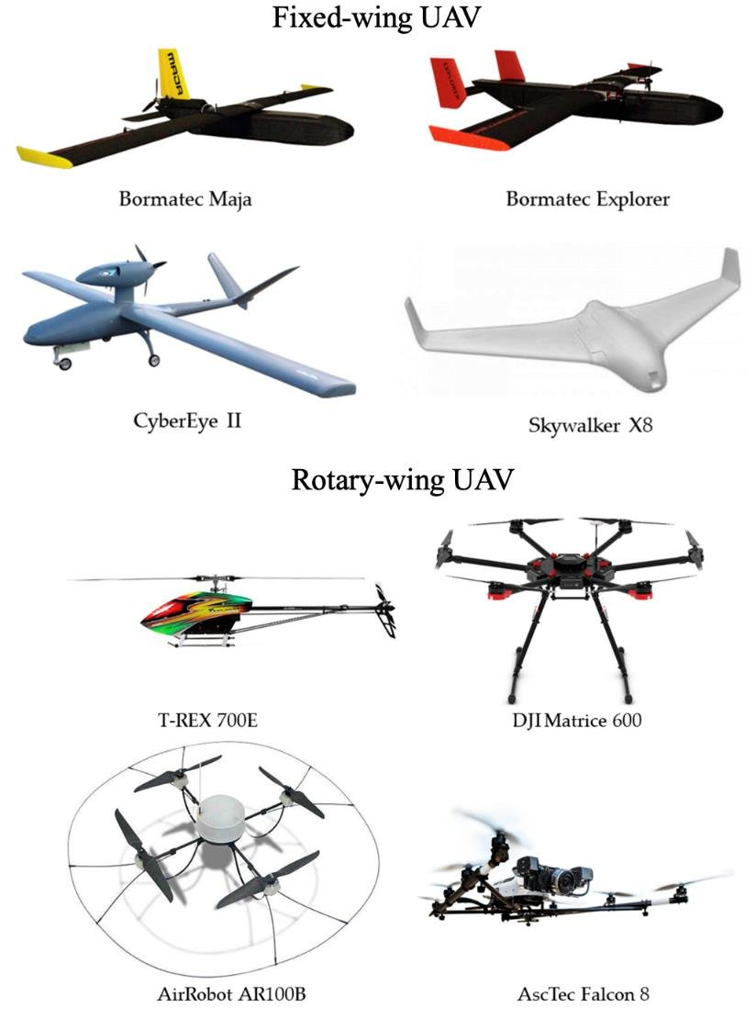
Hull Design
Fixed-wing UAVs: Fixed-wing UAVs have a fuselage that houses the electronic components and payload, and a set of wings that provide lift and stability. They are typically designed for longer-range flights and can be used for applications such as aerial mapping, surveillance, and agriculture. Examples include the DJI Matrice 300 RTK and the SenseFly eBee X.
Rotary-wing UAVs: Rotary-wing UAVs, also known as multirotor UAVs, have a central body that houses the electronic components and payload, and several rotors that provide lift and stability. They are typically used for shorter-range flights and can be used for applications such as aerial photography, inspection, and search and rescue. Examples include the DJI Mavic Air 2 and the Yuneec Typhoon H Plus.
Hybrid UAVs: Hybrid UAVs combine features of both fixed-wing and rotary-wing UAVs. They have a central body that houses the electronic components and payload, and a set of wings that provide lift during horizontal flight. They also have rotors that provide lift and stability during vertical takeoff and landing. They are typically used for applications such as aerial mapping, surveillance, and inspection. Examples include the Quantum Systems Trinity and the MMC HyDrone 1550.

Slide 9
Propulsion System
Electric motors: Electric motors are the most common type of propulsion system used in small UAVs. They are lightweight, efficient, and can be powered by batteries. They are typically used in multirotor UAVs, such as quadcopters, and provide both lift and control.
Gasoline engines: Gasoline engines are commonly used in larger UAVs that require more power and longer flight times. They are typically used in fixed-wing UAVs and provide the necessary thrust to propel the UAV forward.
Jet engines: Jet engines are used in high-performance UAVs that require high speeds and altitude. They are typically used in military UAVs and provide the necessary thrust to propel the UAV forward.
Hybrid systems: Hybrid propulsion systems combine the advantages of electric motors and gasoline engines. They use an electric motor for takeoff and landing and a gasoline engine for cruising flight. These systems are typically used in medium-sized UAVs and provide a balance of power and efficiency.

Slide 10
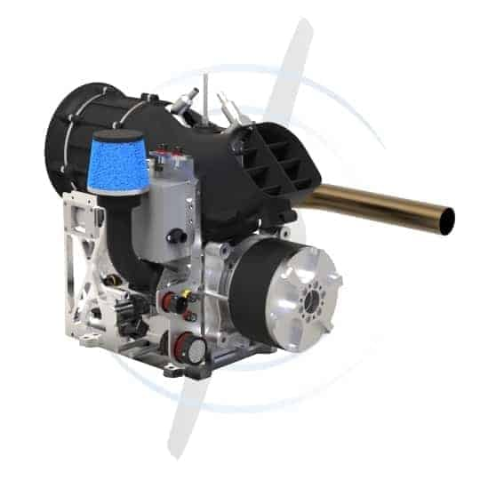
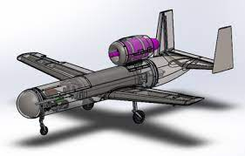
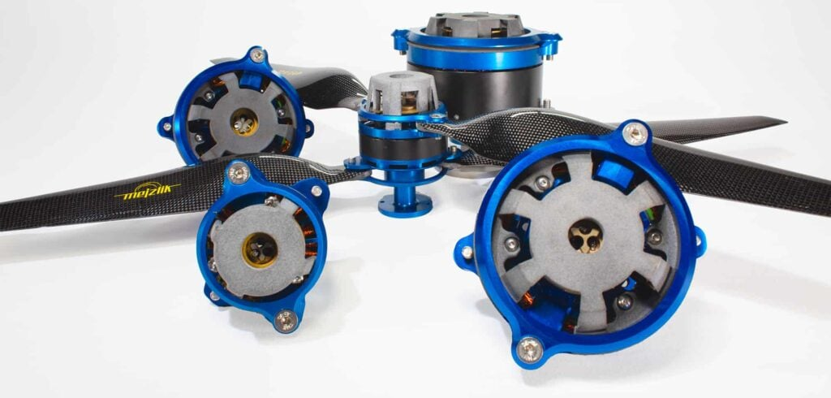

Slide 11
Navigation System & Control
GPS: GPS (Global Positioning System) is a widely used navigation system in UAVs. It provides accurate position, velocity, and timing information, which is essential for flight planning, navigation, and control. GPS is typically integrated with other sensors, such as IMUs, to improve accuracy and reliability.
Inertial Measurement Units (IMUs): IMUs are sensors that measure the UAV's acceleration and angular rate to determine its position and orientation. They are commonly used in conjunction with GPS to provide accurate navigation information.
Magnetometer: A magnetometer is a sensor that measures the magnetic field around the UAV. It is used to determine the UAV's heading and can be used as a backup to GPS in case of signal loss.
Barometer: A barometer is a sensor that measures atmospheric pressure. It is used to determine the UAV's altitude and can be used in conjunction with GPS to provide accurate altitude information.
Flight controller: The flight controller is the brain of the UAV's control system. It processes data from the navigation sensors and provides commands to the UAV's propulsion system and other components to control its flight path and altitude. The flight controller can be either onboard the UAV or on the ground station.
Remote control: The remote control is used to fly the UAV manually. It typically includes a radio transmitter and receiver, which allow the operator to send commands to the UAV and receive telemetry data back from the UAV.

Slide 12
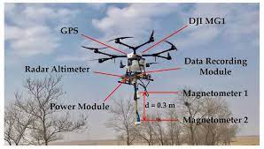
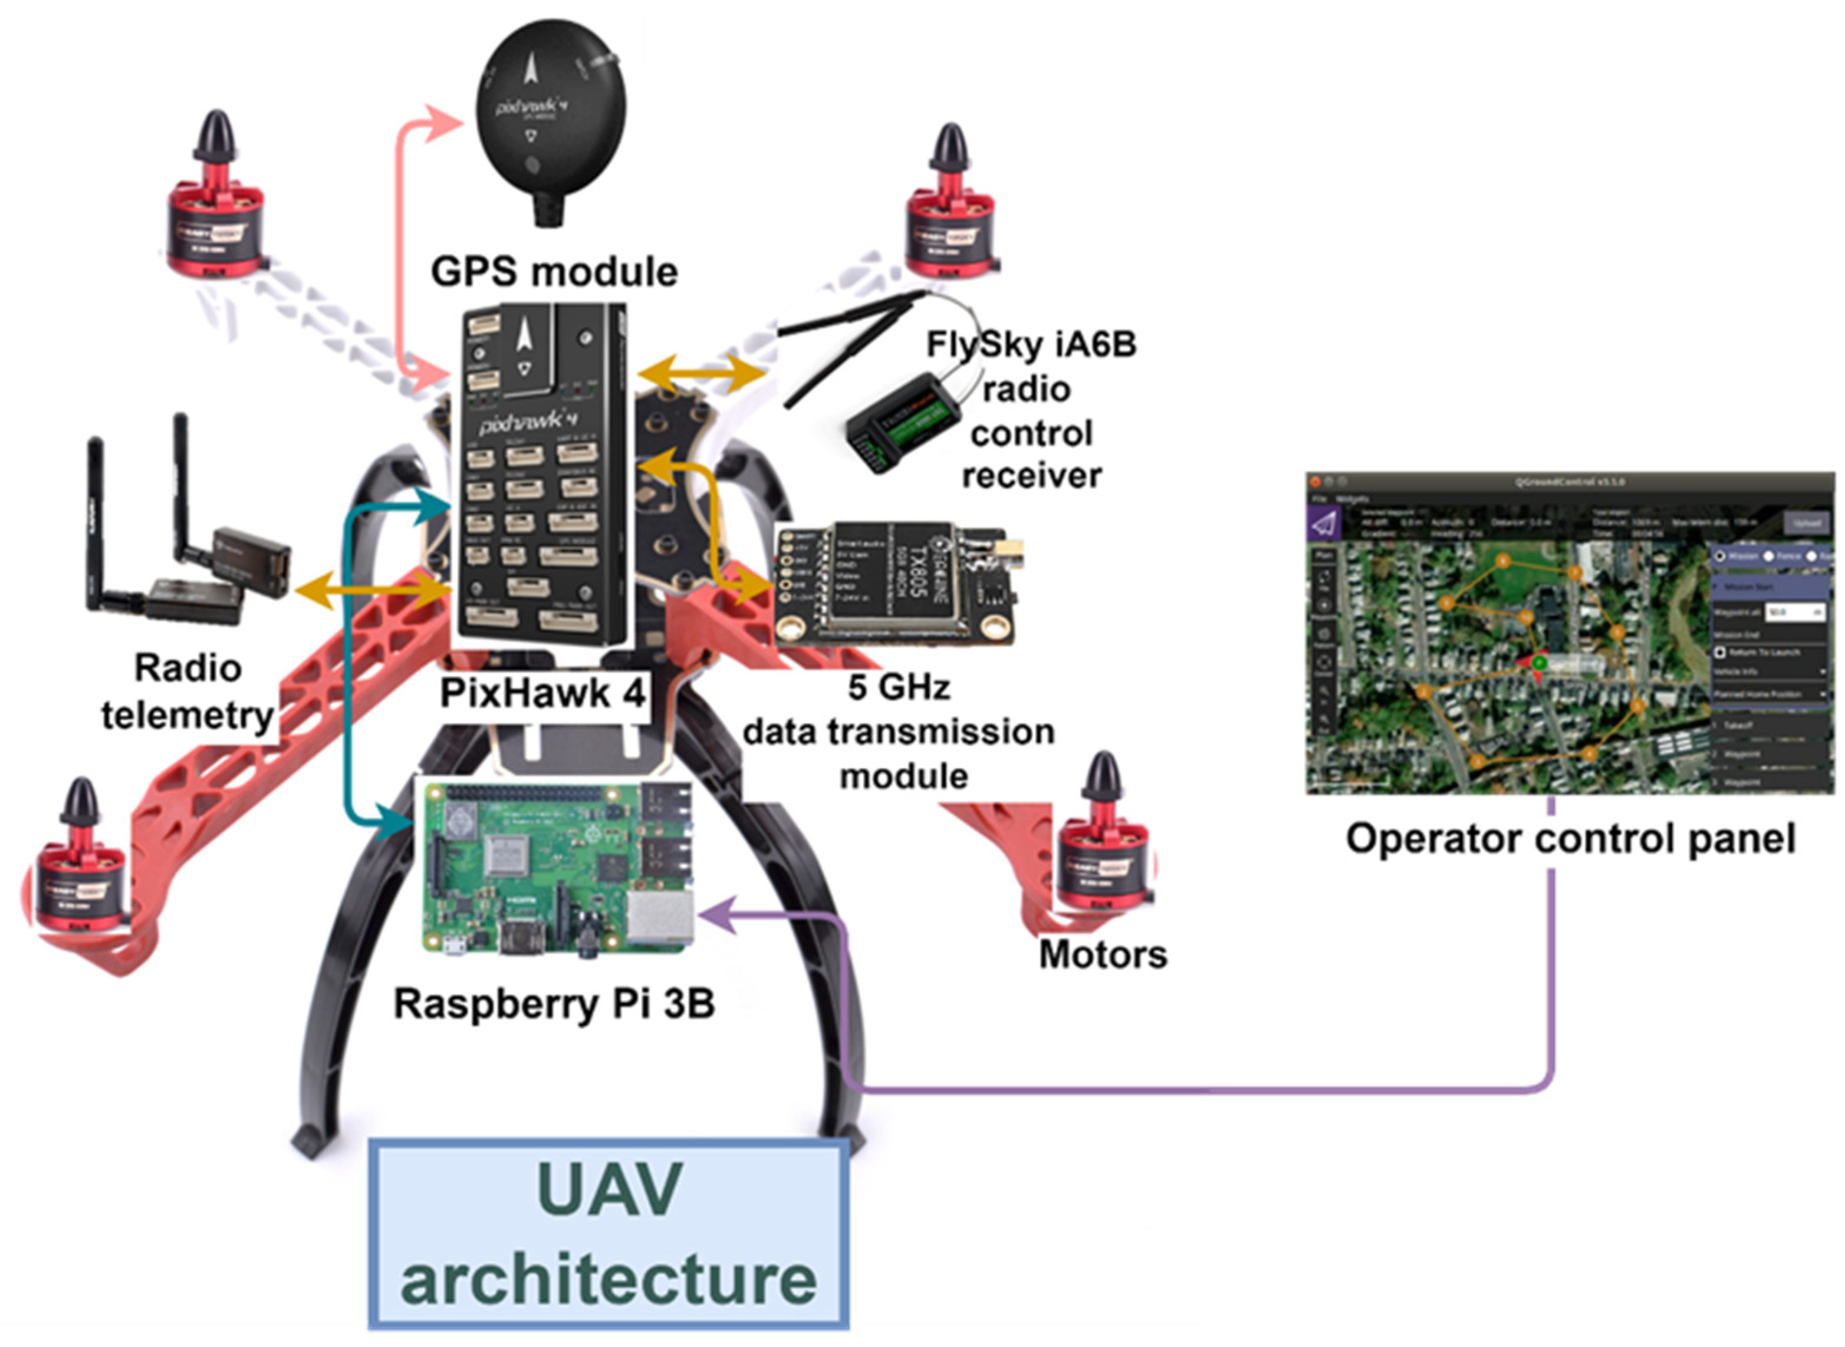
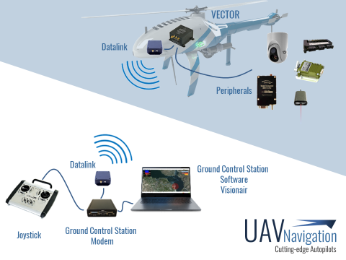
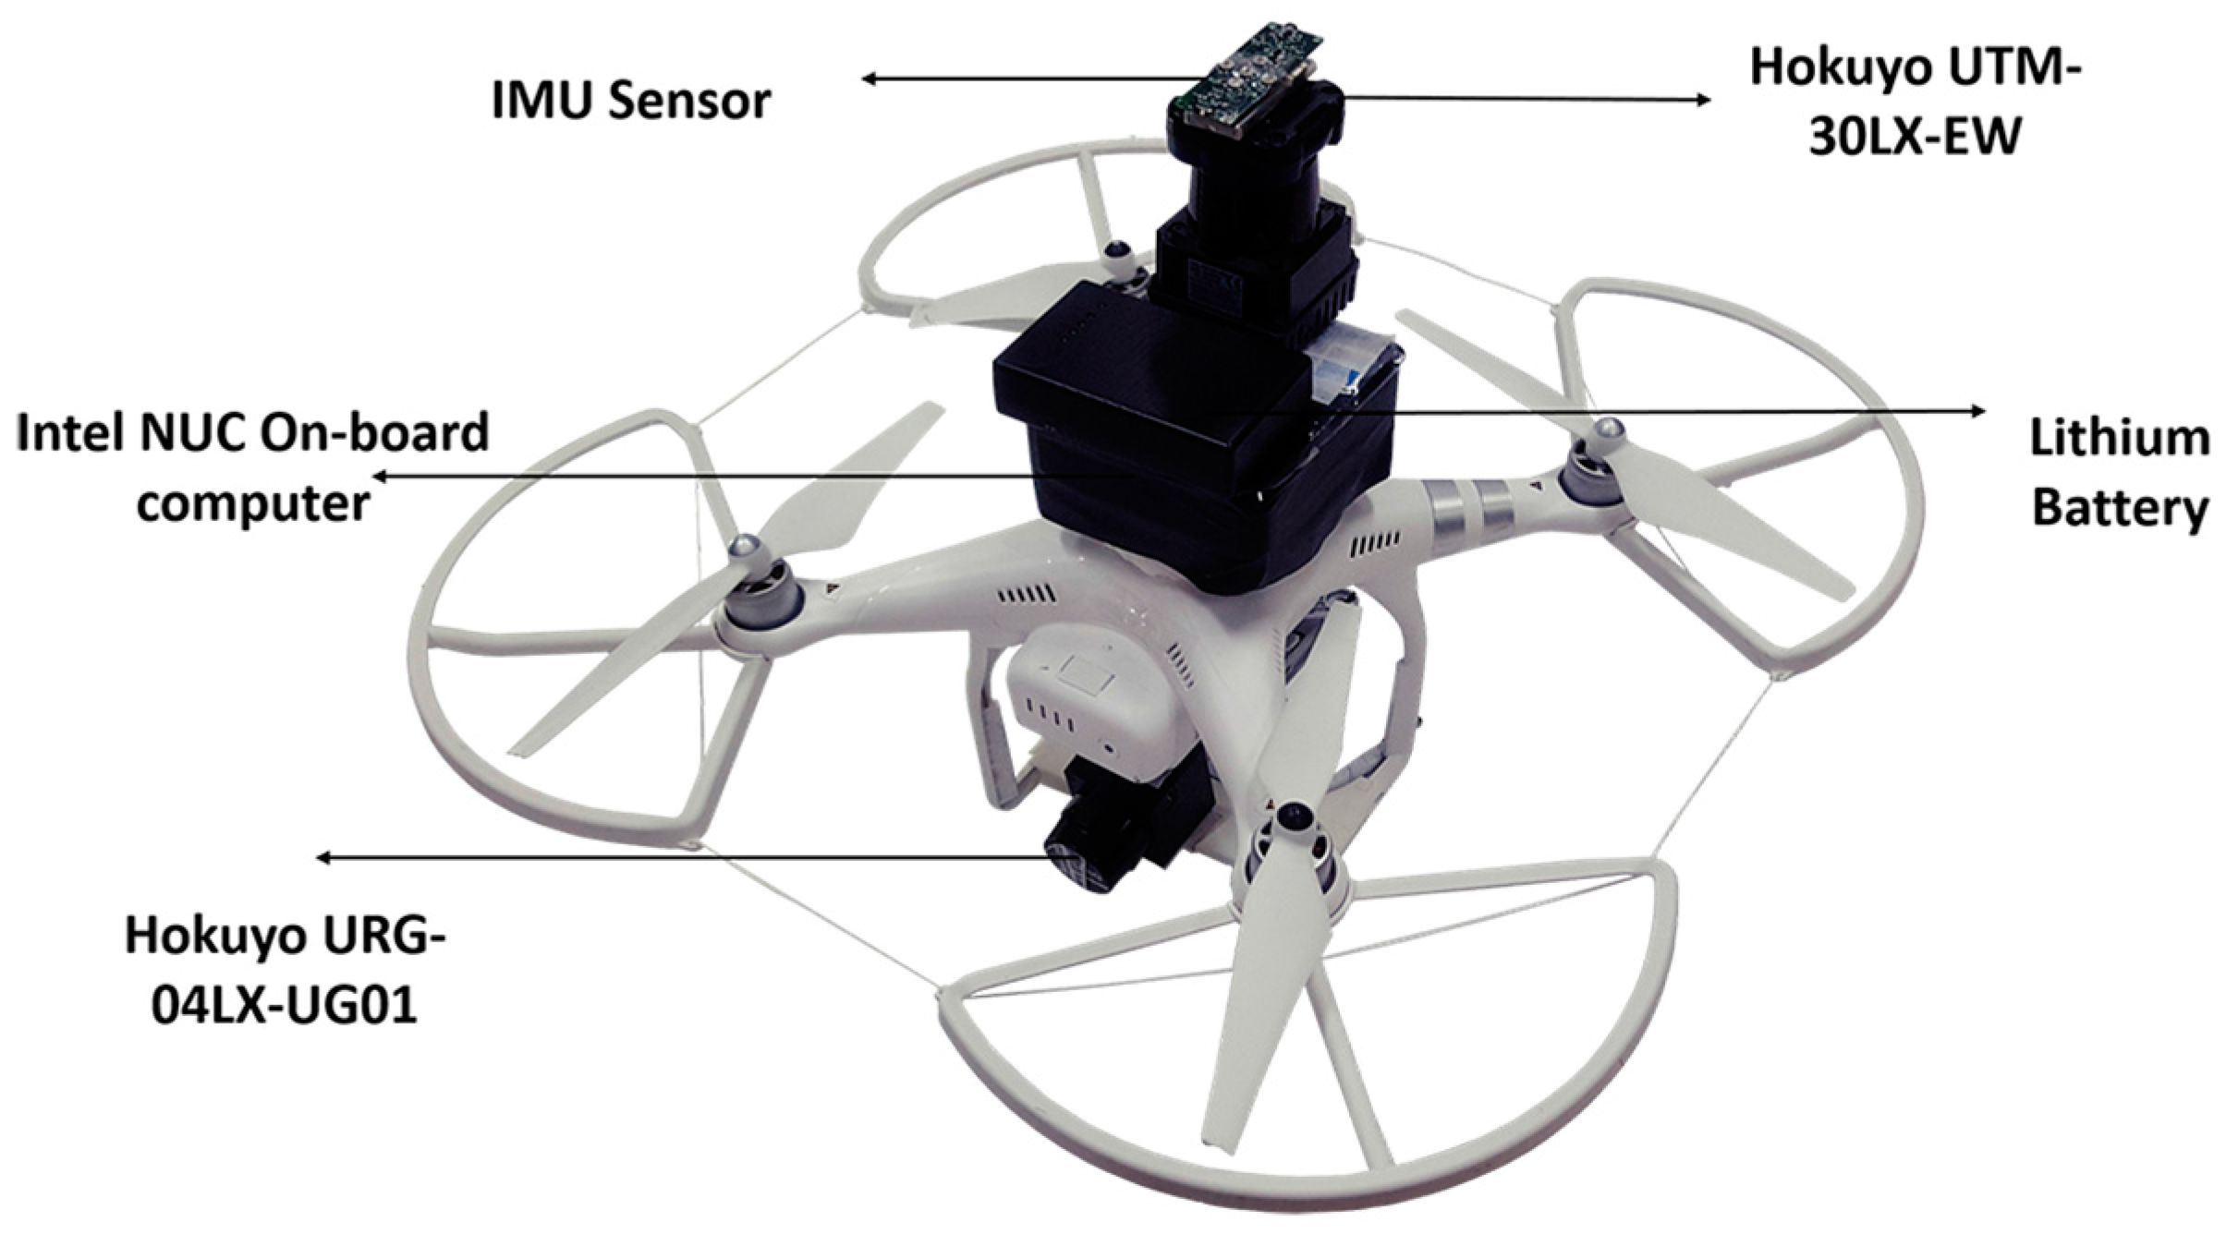

Slide 13
Data Collection
Cameras: UAVs can be equipped with cameras to capture images or video of the ground. These cameras can be visible light or infrared, and they can capture still images or video footage in real-time.
LiDAR: LiDAR (Light Detection and Ranging) is a technology that uses lasers to measure distances and create a 3D map of the environment. UAVs can be equipped with LiDAR sensors to capture high-resolution 3D data of the ground.
Multispectral sensors: Multispectral sensors can be used to capture data in multiple wavelengths of light. This data can be used to create maps of vegetation health, soil moisture, or other environmental factors.
Gas sensors: UAVs can be equipped with gas sensors to measure air quality or detect leaks from pipelines or storage tanks.
Sampling devices: UAVs can also be equipped with sampling devices to collect air or water samples for analysis in a laboratory.

Slide 14
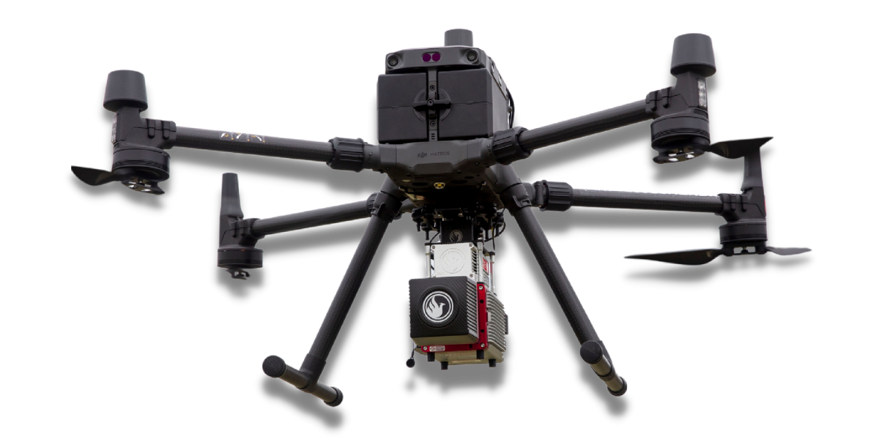
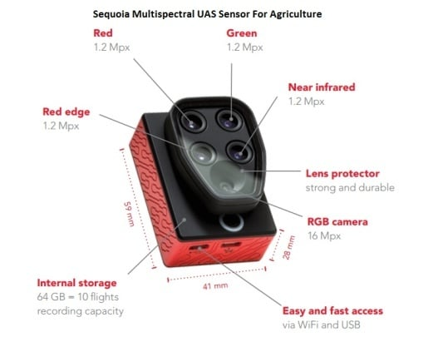
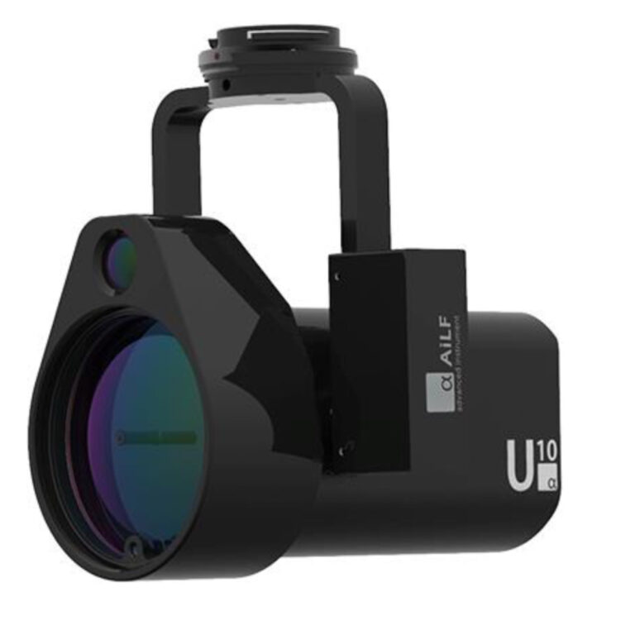
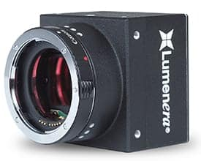

Slide 15
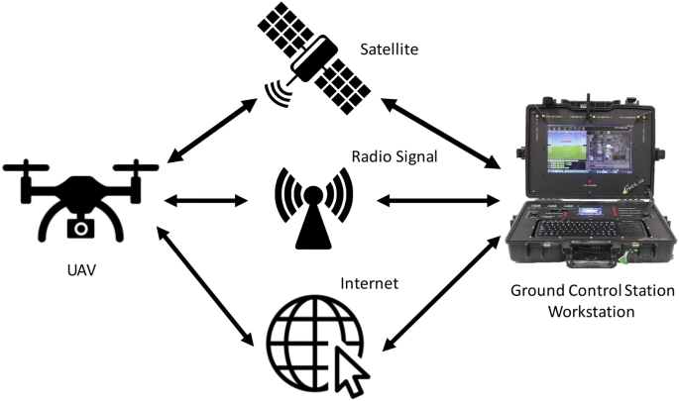
Data Transmission
Radio frequency (RF) transmission: RF transmission is a common method for data transmission in UAVs. The UAV can be equipped with a radio transmitter that sends data to a ground station or other receiving device using a specific frequency band.
Cellular networks: UAVs can also use cellular networks to transmit data. The UAV can be equipped with a cellular modem that connects to the cellular network, allowing for data to be transmitted in real-time.
Satellite communication: Satellite communication can be used to transmit data from UAVs in remote or inaccessible locations. The UAV can be equipped with a satellite modem that connects to a satellite network, allowing for data to be transmitted from the UAV to a ground station or other receiving device.
WiFi or other wireless networks: UAVs can also transmit data using WiFi or other wireless networks. The UAV can be equipped with a WiFi transmitter that sends data to a ground station or other receiving device using a wireless network.

Slide 16
Power management
Battery technology: Batteries are a common power source for UAVs, and advances in battery technology have led to the development of batteries with higher energy density and longer life. Lithium polymer (LiPo) batteries are commonly used in UAVs due to their high energy density, light weight, and ability to deliver high power.
Power distribution systems: Power distribution systems are used to manage the flow of power from the battery or other power source to the various components of the UAV. These systems can include voltage regulators, power converters, and power conditioners, which ensure that the components receive the appropriate voltage and current.
Efficient propulsion systems: Efficient propulsion systems can help to reduce the power requirements of the UAV. Electric motors are commonly used in UAVs due to their high efficiency, low weight, and ability to be controlled electronically.
Power management software: Power management software can be used to optimize the use of power across the various systems and components of the UAV. This can include optimizing flight paths to reduce power consumption, adjusting the power output of the propulsion system based on flight conditions, and monitoring battery usage to extend flight time.
Redundancy: To ensure the safety of the UAV and its payload, power systems should be designed with redundancy in mind. This can include multiple batteries or power sources, as well as backup systems that can be used in the event of a power failure.

Slide 17
